Slide 1

Laundry Tips and Tricks

Slide 2
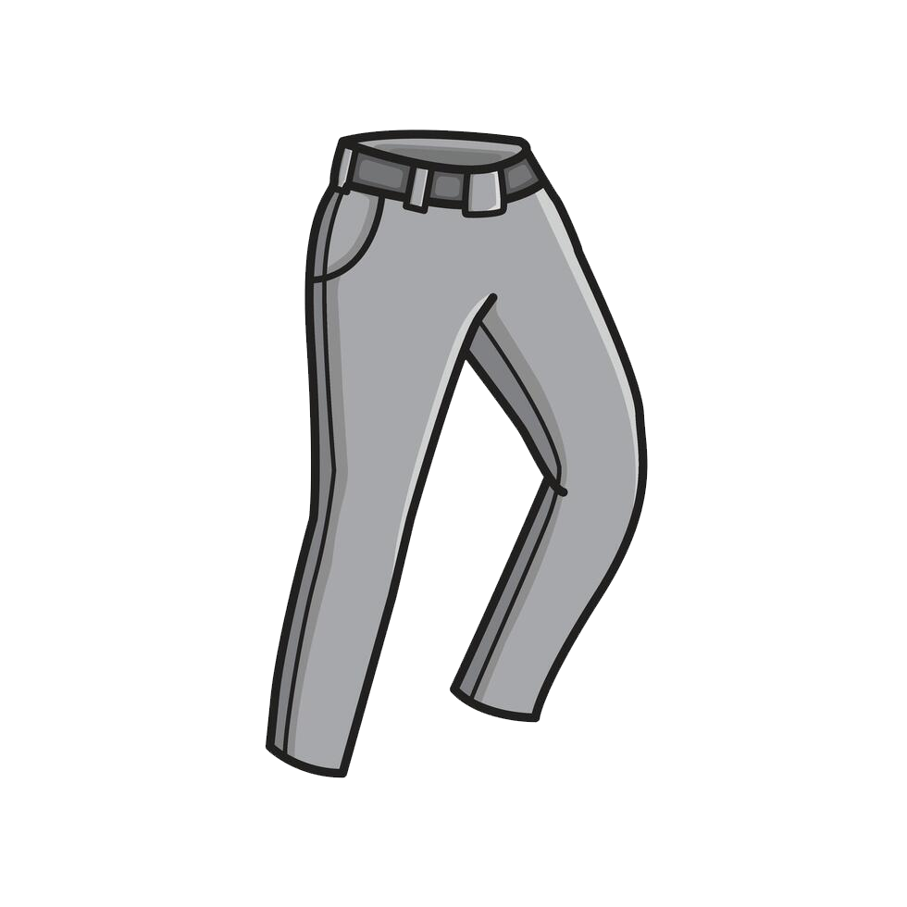





Check all clothing
for loose items and remove before washing

Slide 3
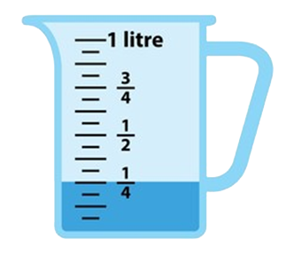

Use ONLY ¼ cup of liquid soap or 1 pod

Slide 4
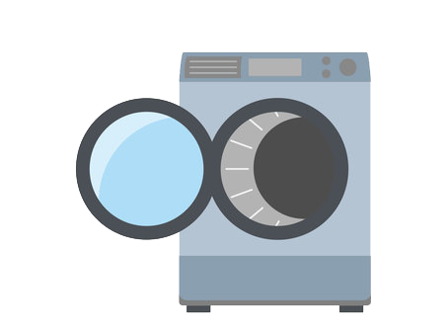

PODS must be placed inside of drum before clothes

Slide 5

DO NOT add any water
to machines

Slide 6


Make sure machine
door or lid is closed
properly

Slide 7
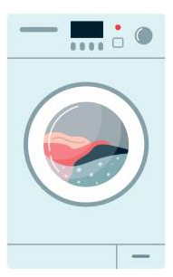
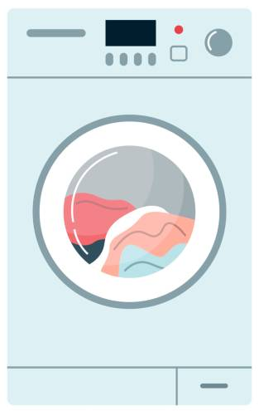
1 Wash Load = 1 Dry Load

Slide 8
DO NOT load machine more than 2/3 full
2/3

Slide 9



Articles soiled with vegetable or cooking oil should never be put in the dryer. Residual oil may cause the fabric to ignite in the dryer.

Slide 10
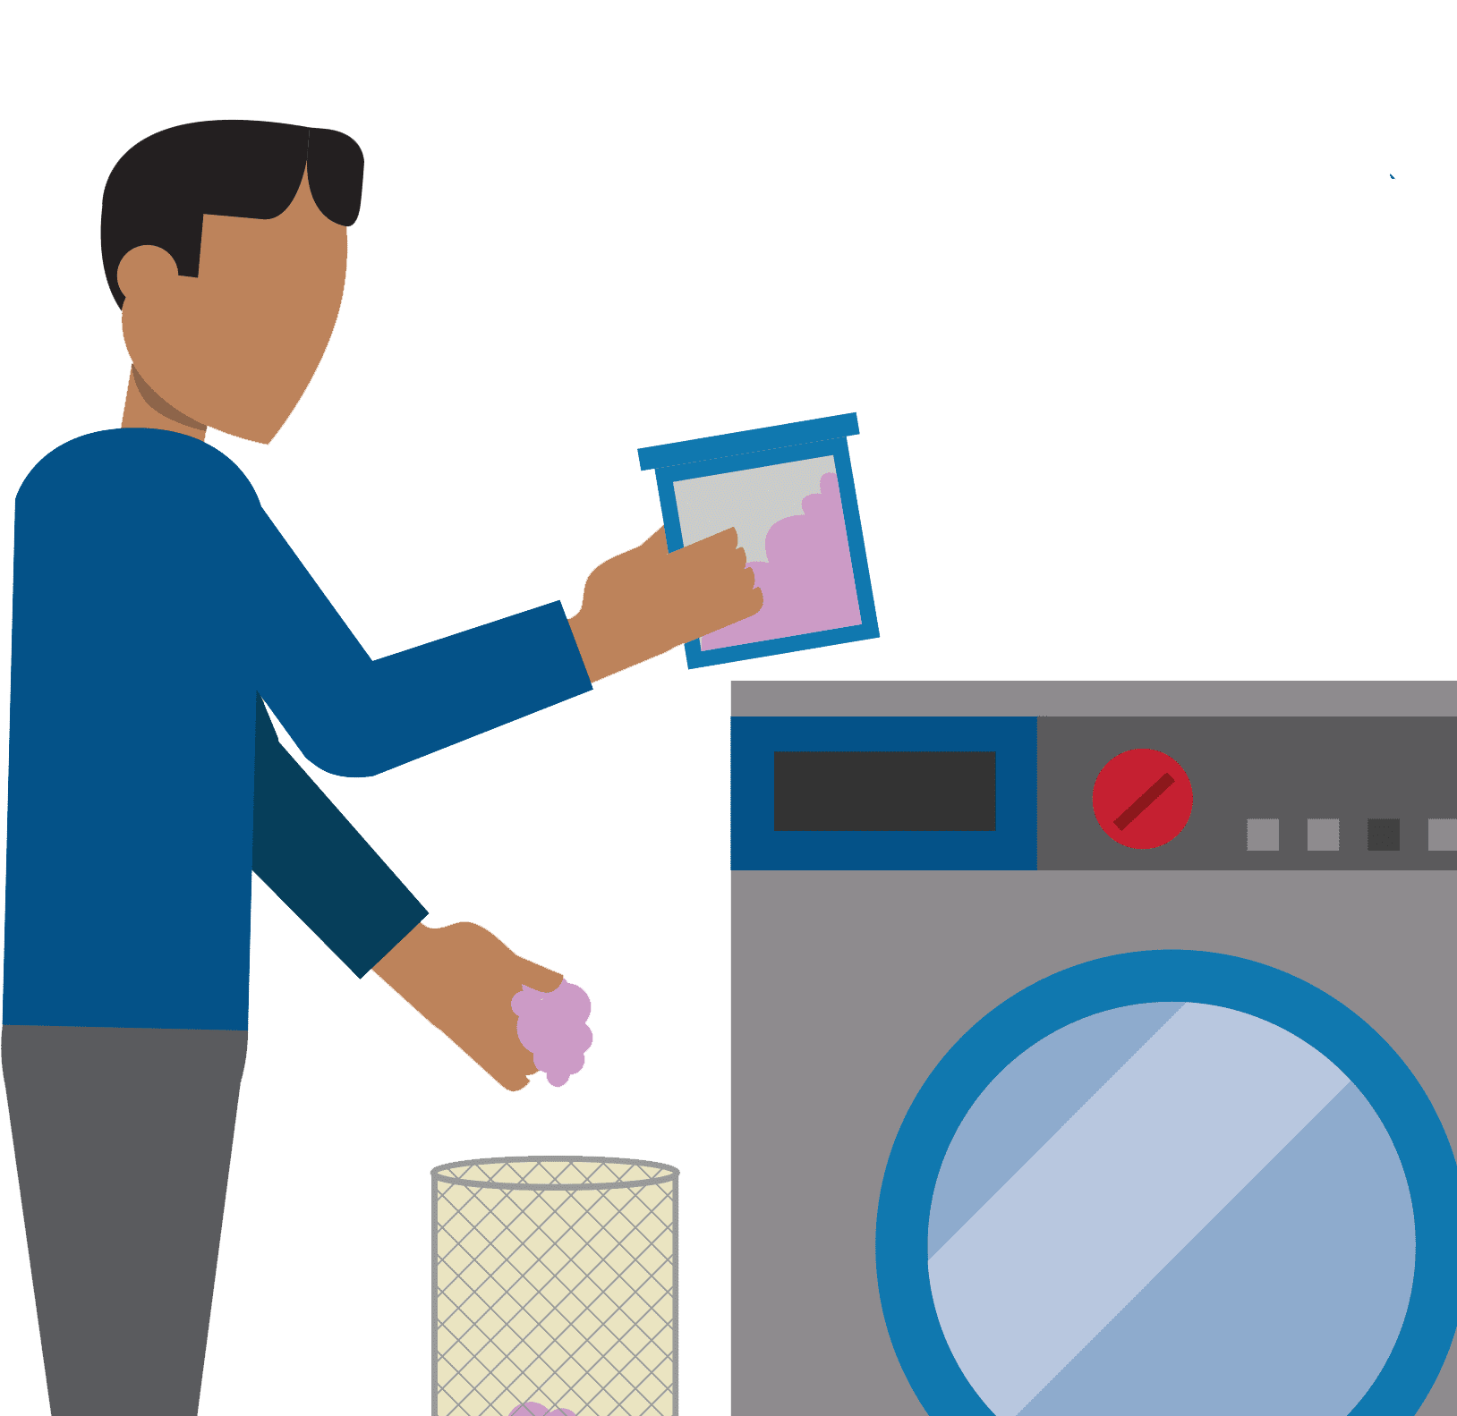
Clean lint filter before
and after drying

Slide 11


DO NOT wash or dry plastics or rubber materials

Slide 12
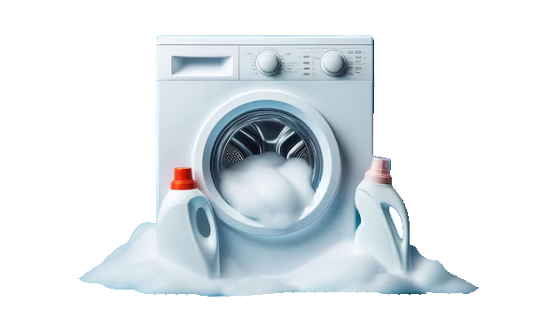
DO NOT over soap,
your washer only needs 1 pod or ¼ cup of detergent

Slide 13
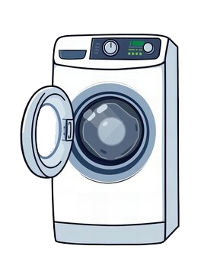
Keep it fresh,
leave washer door open after each use

Slide 14

DO NOT wash or dry
comforters, pillows or
bulky items

Slide 15
Laundry Stain Removal Tips

Slide 16

Remove stains from whites with lemon
juice

Slide 17

Remove blood stains or other bodily fluids with household peroxide

Slide 18
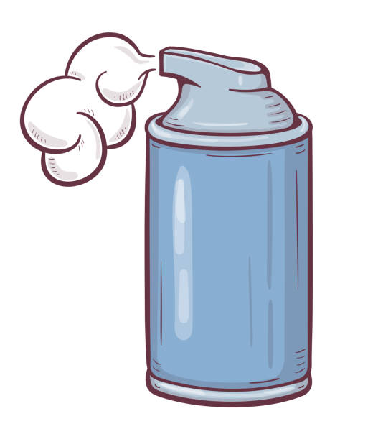
Remove makeup stains with shaving cream

Slide 19
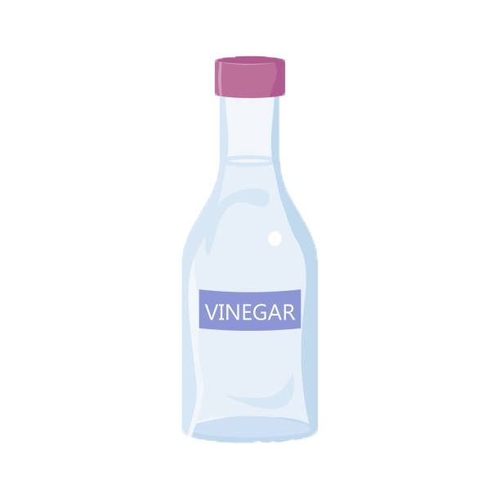
Distilled white vinegar kills mildew and is great for a variety of stains

Slide 20

Dish soap works great to pretreat oil or grease stains on laundry

Slide 21
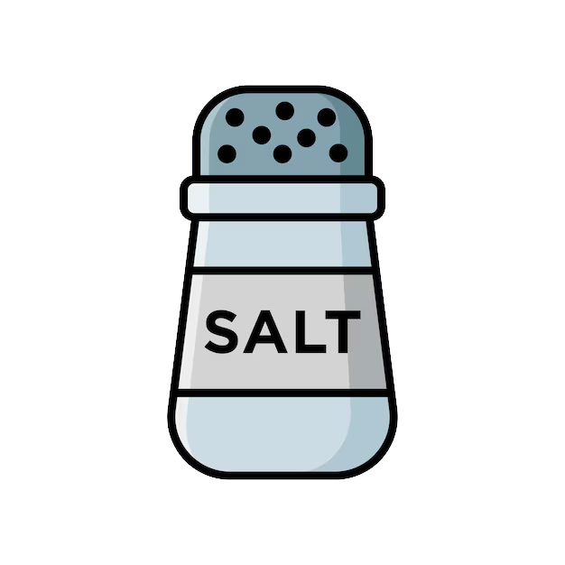
To remove red-wine stains, pour a big dose of salt on top of the stain to absorb the liquid

Slide 22
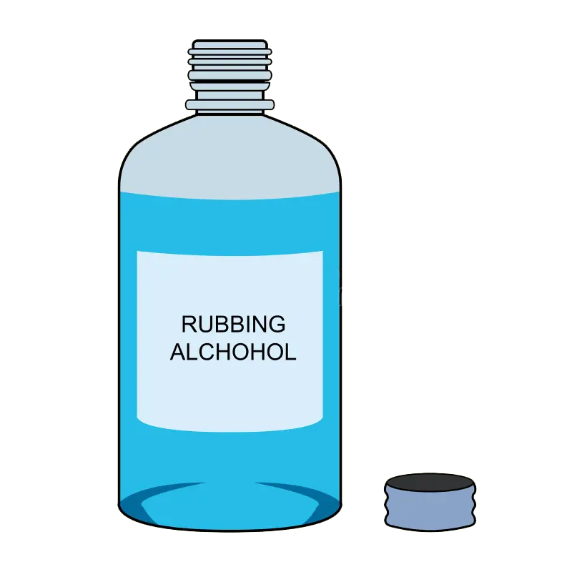
Lipstick stains can be removed with isopropyl rubbing alcohol

